Slide 1
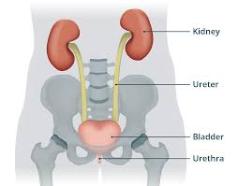
URINARY SYSTEM
EKU NURSING STUDENTS SENIOR BLOCK
Victory Ogaga

Slide 2
Urinary system
Not just removing urine(Tho it is it primary function)
Functions
1. Removes metabolic waste
2. Regulates blood volume and pressure
3. Regulates Plasma Conc of sodium, potassium and chloride e.t.c Na+, K+, Cl-
4. Helps to stabilise blood PH(Normal PH is 7.4)
5. Conserve valuable nutrients

Slide 3
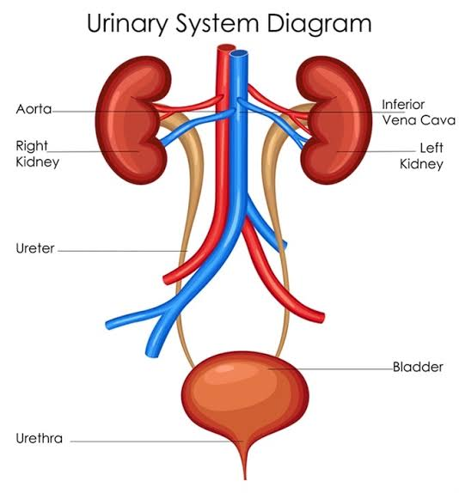
Organs /Tissue of the urinary system
1. Kidney
2. Ureters
3. Urinary Bladder
4. Urethra

Slide 4
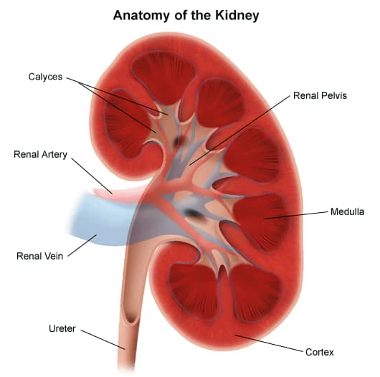
Kidney anatomy
2kidneys on either side of the spine. The left Kidney is slightly superior to the right one
It is reddish brown, Renal cortex, renal medulla, renal pyramid, major/minor calyx, renal pelvis and Hilum

Slide 5
Blood flow to the Kidneys
1. In healthy individuals, over 1 liter of blood flows through the kidneys each minute
2. Recieve blood through renal arteries
3. Blood leaves through renal veins
4. Blood flow regulated by renal nerves

Slide 6
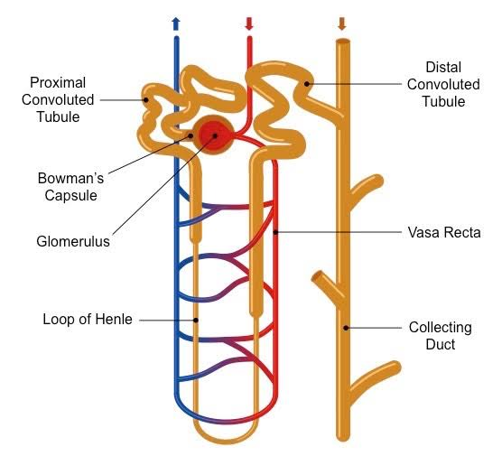
Nephrons
They are the little filtering unit of the kidney. They are tubular structures in the the cortex of the kidney that do the filtering of blood and production of urine.
1.25 million nephrones per kidney.

Slide 7
Glomerulus
Bowman's capsule
Proximal convoluted tubule (PCT)
Loop of Henle
Distal convoluted tubule (DCT)

Slide 8
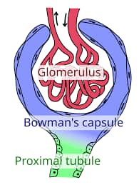
Glomerular filtration
Glomerulus is a bunch of capillaries
Blood pressure forces water and small solutes across the membrane and into the capsular space

Slide 9
Some important nutrients (glucose, fatty acids, amino acids, vitamins) can also pass through.
These are reabsorbed in PTC

Slide 10
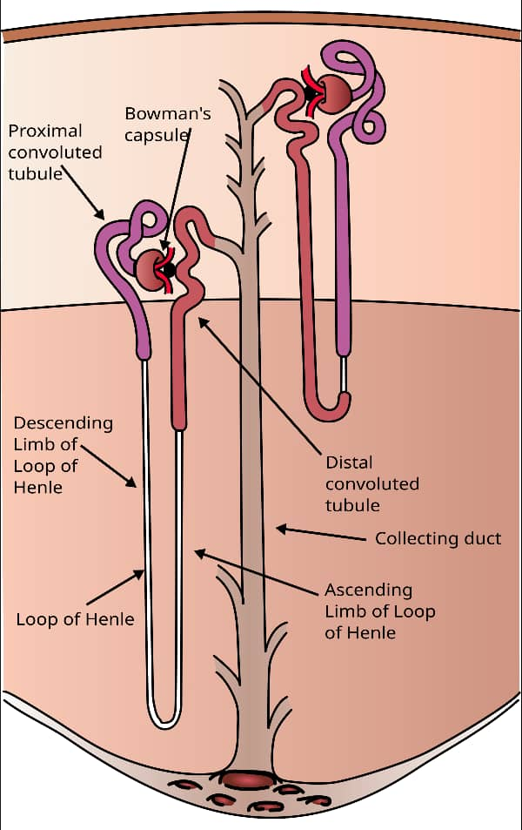
Right after we leave the glomerulus, a mixture of water, solutes e.t.c comes in
So reabsorption of nutrients, ion, water and plasma proteins happens here
Released into the peritubular fluid
Blood stream

Slide 11
Loop of Henle
Found in the modulla area if kidneys
Pumps put sodium and chloride ions, which move water out of the tubule
Water movement out of the loop helps concentrate the tubular fluid

Slide 12
DCT
Importance
1. Actively secrets ions, acids, drugs, toxins
2. Selectively absorbs sodium and chloride calcium ions
3. Selectively absorbs water
(Finalising what is going to become a urine )

Slide 13
Collecting system
Now, concentrated urine passes through the collecting duct
The fluid empties into the minor calyx which leads to the major calyx
Major calyx leads to the pelvis, then to the ureters

Slide 14
Urine
Approx 95% water
Urea: comes from breakdown of amino acids
Creatinine: comes from break down of creatine phosphate (from muscles)
Uric acid: formed from recycling of nitrogenous bases of RNA
Urobilin: a byproduct of the breakdown of bilirubin

Slide 15
Urinary conditions/ Disorders
1. Urinary tract infections (UTI)
2. Kidney stones
3. Kidney dialysis

